Slide 1


Slide 2






Overview

Slide 3


Slide 4



Project4.0 Goals
Goals
Capstone integration project
Authentic project, with external product owner
Level up on ‘Soft’ skills (& ‘Hard’ skills)
Level up on collaboration skills, with multidisciplinary DevOps teams

Slide 5
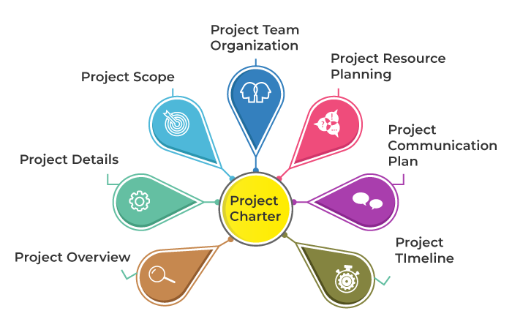
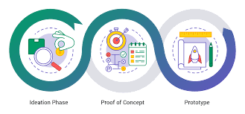
Project4.0: Phases
Phases
Ideation Phase
Sprint 0
‘Analysis’ part
Who? What? Why?
Timing: September / October
‘Refinement into a Concept’ part
How?
Timing: November / December
Deliverable: Project Plan / Concept
Realization phase
Sprint 1-4
Create a Proof of Concept / Prototype
Timing: January / February

Slide 6
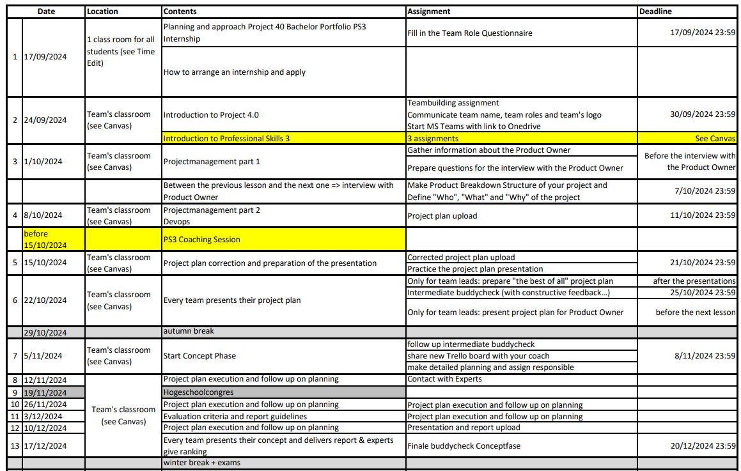
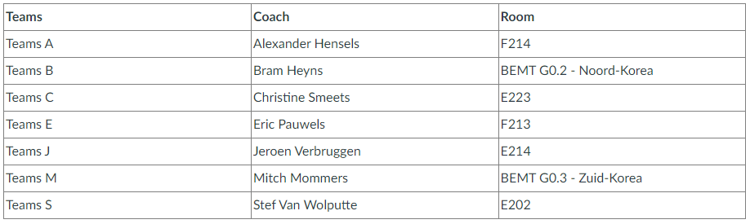
Project4.0: Detailed Planning
Planning
Detailed planning on Canvas
Might differ per project coach
Check Canvas for latest version

Slide 7


Slide 8

Project4.0: Expected Workload
Workload
Ideation Phase – A (Preparation)
Workload: 6 hours / week
Duration: the first 6 weeks (until autumn break)
Tuesday, lesson blocks 1 & 2. With coaches. On campus (check Canvas). Mandatory attendance.
+/- 3 hours of teamwork, flexible when/where (Online, Hive, Agora,…). Discuss in team.
Ideation Phase – B (Concept)
Workload: 10 hours / week
Duration: the next 7 weeks (until winter break)
Same workload as during Phase A. Mandatory attendance.
Extra workload: >= 3 hours for individual contributions to the project charter / plan. Flexible when/where.
Extra workload during last week for finalizing project plan, documentation, presentation
Realization Phase
Workload: full time (36 hours /week)
Duration: 3-4 weeks in January / February (after the winter exams)
Full time mandatory attendance (can be mix between online, on campus, on prem with product/business owner,…)
Exception: 2nd year courses → discuss with team on how to recuperate those hours (at night, during the weekend,…)

Slide 9
Project4.0: Stakeholders
Stakeholders
Project / Product Owner (external company)
Defines project challenge
Evaluates the ideation phase (Project Plan), and the realization phase (PoC / Prototype)
Project Coach
Guide, coach. Explains projectmanagement.
Evaluates the process, and overall result
Subject Matter Experts (SME) (= project coaches from Project 4.0)
Go-to technical experts
Helps with evaluation of technical progress
DevOps team
Multidisciplinary student team
Self & Peer evaluation

Slide 10


Project4.0: Evaluation
Evaluation
Process
Making steady progress, meeting deadlines, adhering to agreements, applying feedback
Communication with stakeholders (formal & informal)
Deliverables
Result of the Ideation Phase → scoring: 50% (incl. process)
Evaluation based on contents and form of documentation & presentation of Project Plan / Concept
Result of the Realization Phase → scoring: 50% (incl. process)
Evaluation based on contents and form of documentation, presentation & live demo of Prototype / Proof of Concept

Slide 11
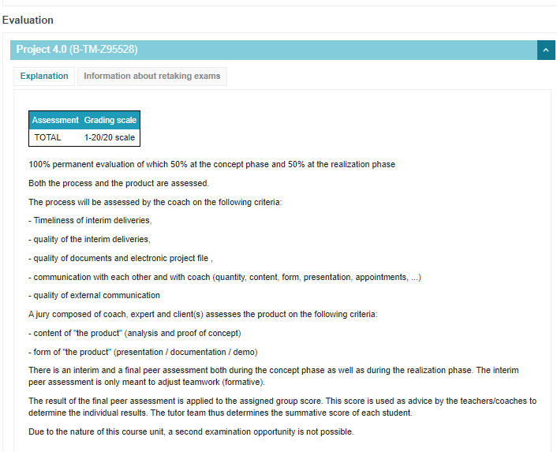
ECTS
Evaluation
No 2nd Chance

Slide 12

Peer Evaluation
Evaluation
Weighting factor to transform team score to individual score
When
Halfway the Ideation phase – formative eval
End of the Ideation phase – summative eval
Halfway the Realization phase – formative eval
End of the Realization phase – summative eval
How
Via Buddycheck on Canvas
Each team member evaluates all other team members AND justifies given scores
Each team member does self-evaluation (‘expected own score’)

Slide 13
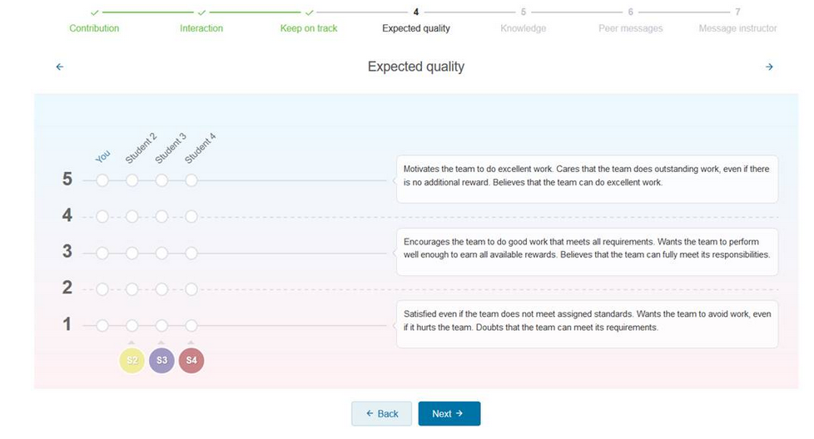
Peer evaluation = Soft & Hard skills!
Evaluation

Slide 14
Peer Evaluation
Evaluation
Coach monitors formative evaluations:
Sufficient justification, clear & constructive feedback, …
The justification & quality of your feedback will be factored in when determining your individual score.
Your feedback will be discussed during PS3 coaching
Tips:
Be concrete and specific
Identify the behavior and spare the person
Provide targeted feedback
Don't bring up old issues
Invest in your relationships
Give constructive feedback
Address issues with the "I-message"

Slide 15

Peer Evaluation: Tips
Evaluation
Notes:
Another tip:
https://www.youtube.com/watch?v=hEWCVBETSEw

Slide 16
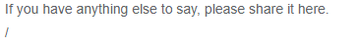
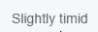
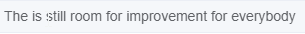
Peer Evaluation – Feedback fails highlights
Evaluation

Slide 17
Peer Evaluation - good examples
Evaluation
“You did well with the quality of your work, but I think you spent a bit too much time on the first part of the project. In the future, breaking the work into smaller tasks with time-limits, might help you manage your time more effectively.”
“Your presentation was engaging, and I loved how you used examples to illustrate your points. One thing that could make it even better, is if you paced yourself a bit slower; it felt a little rushed in parts.”

Slide 18

Peer Evaluation - Scoring
Evaluation
Evaluation score is a normalized score for the team
Score of “1” → team average
Score >1 → above team average
Score < 1 → below team average
Students having a Peer Evaluation-score < 0,85
=> close follow-up corrective actions
Notes:
https://www.youtube.com/watch?v=fGWYyvPhsf8&t=1s
https://www.youtube.com/watch?v=hEWCVBETSEw

Slide 19


Slide 20
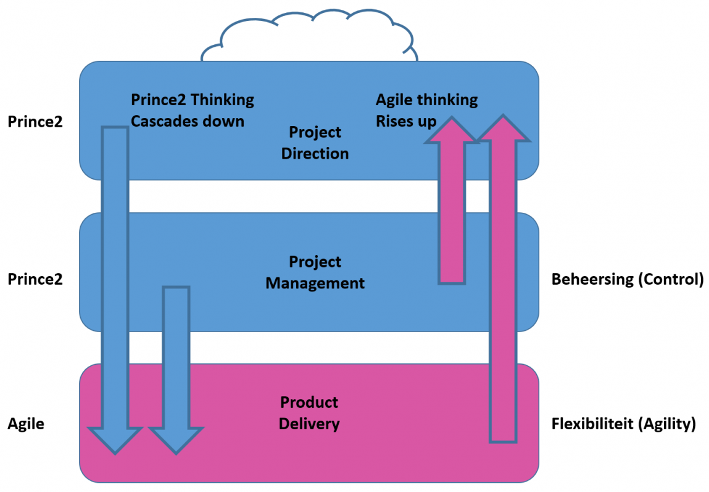
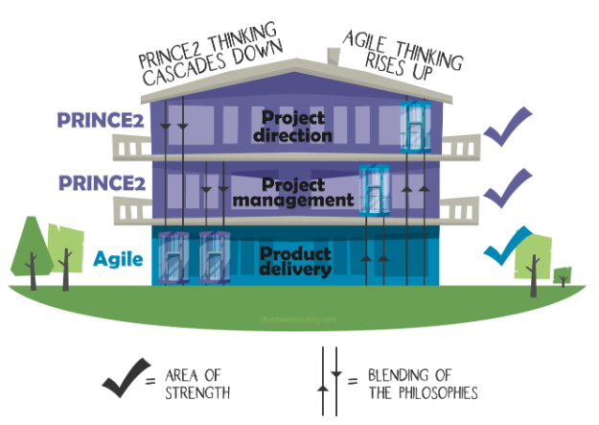
Prince2 & Agile: ‘the blend’
ProjectMgmt
Notes:
https://www.knowledgetrain.co.uk/res/ebooks/prince2-vs-agile-comparison-ebook.pdf
https://medium.com/swlh/is-a-prince2-certification-worth-it-53695e4c0c37

Slide 21
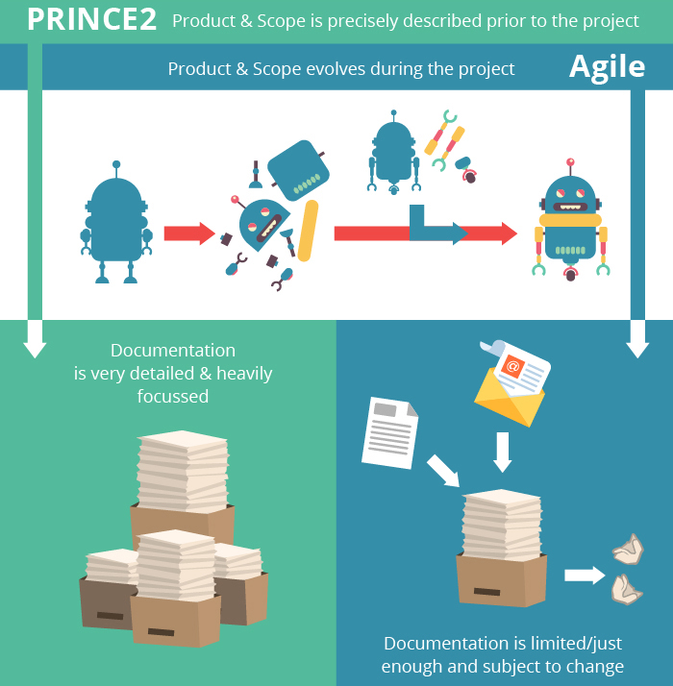
Prince2 >< Agile
ProjectMgmt

Slide 22




Project4.0: Two Main Phases
ProjectMgmt
Ideation Phase
‘Prince2’-ish
What?
Why?
How?
Deliverable:
Concept
Realization Phase
‘Agile’-ish
Create
Check
Repeat
Deliverable:
MVP, and then some!

Slide 23


Slide 24
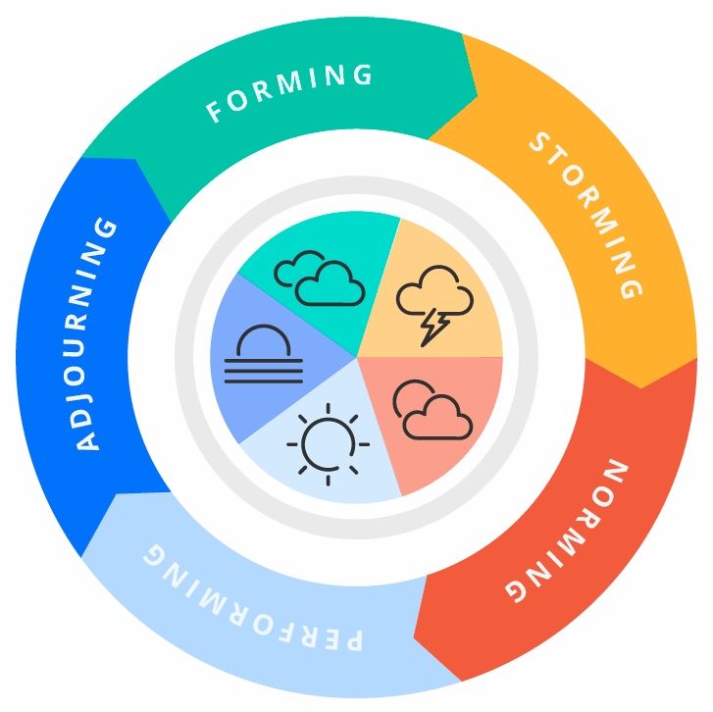

Stages of Team Dynamics (Tuckman)
Team

Slide 25
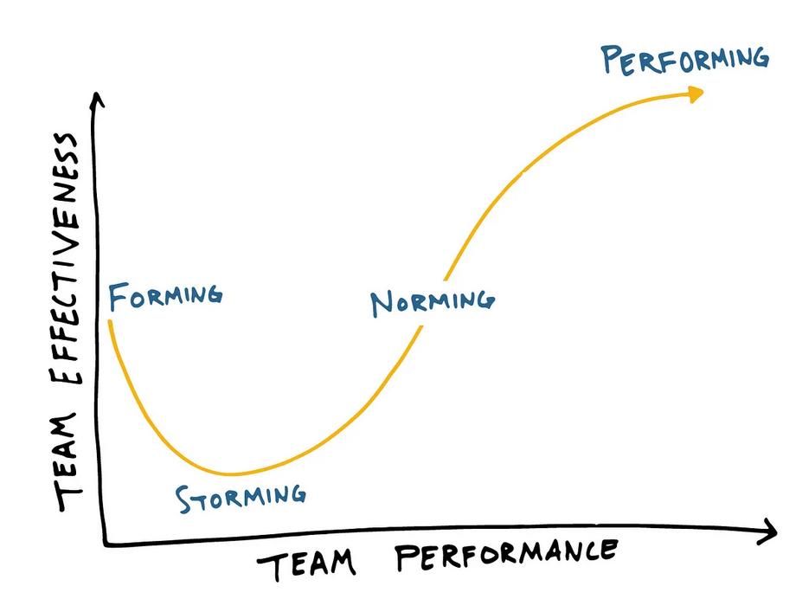

Slide 26
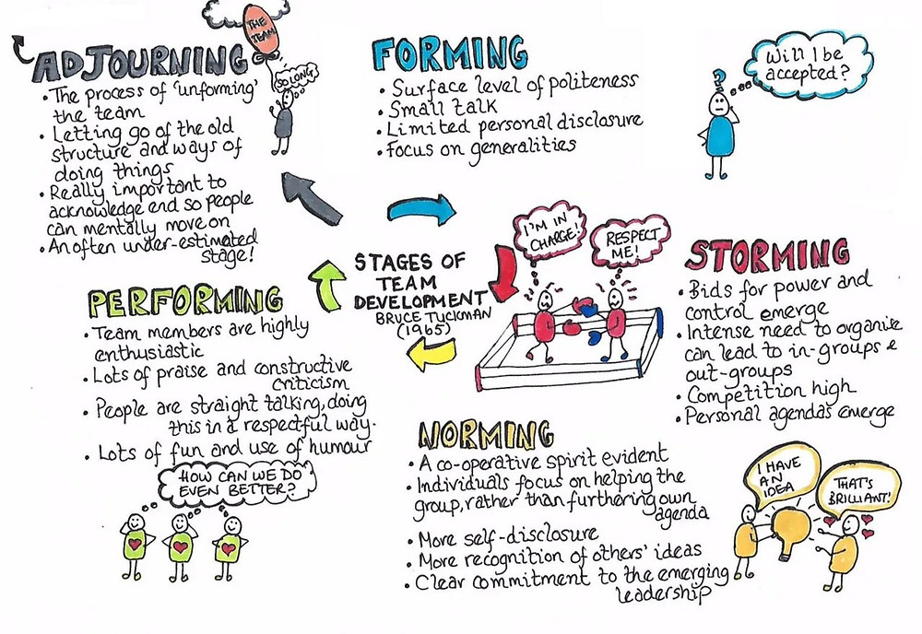

Slide 27



Team Member roles
Team
Team Member
Team Lead
Case File Manager

Slide 28
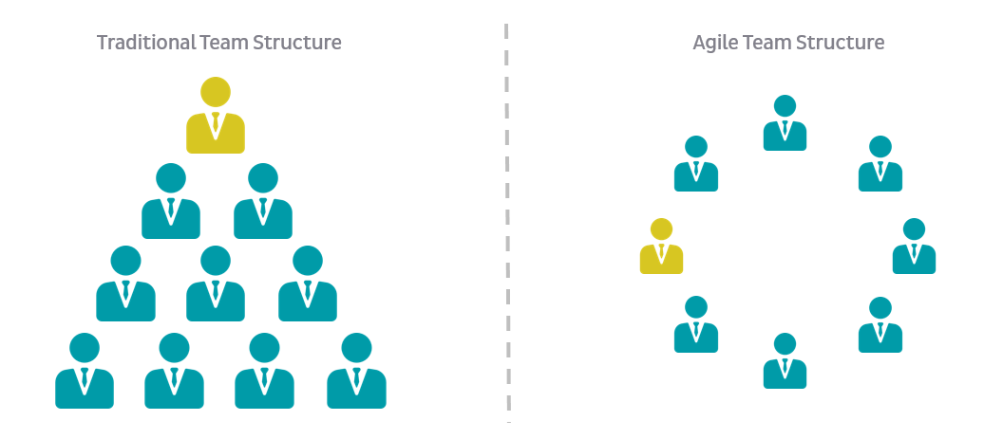
(Agile) Team Member
Team
Part of the whole, and as such also accountable and responsible for the whole
Everybody contributes to everything
Brainstorming, researching, documenting, decision making, quality assurance, presenting, …
Skillset and motivation will determine where you will be most valuable to the team, and do most work

Slide 29
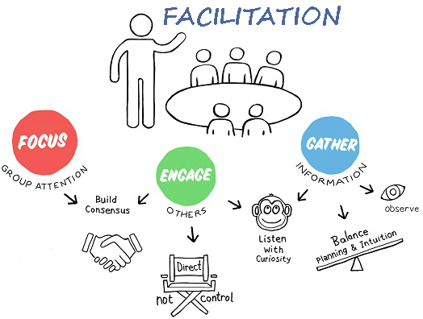
Team Lead / Facilitator
Team
Facilitates teamwork
Delegates tasks according to strengths
Part of the team, so also does part of the work
Single Point of Contact for ‘outside’ stakeholders
Communication with project coach, business owner, other team leads, …
Has deciding vote in team’s decision-making process

Slide 30

Case File Manager
Team
Maintains the dedicated MS Teams project group
Used for online meetings, online coaching,…
Gathers, structures & shares all project documents (through MS Teams)
Connects the Project Management Software, PMS (Jira, Trello, Monday,…), to MS Teams group
Makes sure Team Coach has same access as other team members
Don’t include Team Coach in each call!

Slide 31


Slide 32
Team Roles
Team
During Ideation phase
Team decides who will fulfill which role & when
Flexible roles: switch halfway through the ideation phase
During Realization phase
Team decides who will fulfill which role
Fixed roles for ‘project lead / scrum master’ & ‘Case File Manager’
First part Ideation phase | Last part of Ideation phase
Team Lead | (Agile) Team Member
Case File Manager | (Agile) Team Member
(Agile) Team Member | Team Lead | Case File Manager | (Agile) Team Member

Slide 33


Slide 34

Project Coach
Coach
Project4.0
Team coaching
via communication with team lead, via team meetings, via checking shared documentation (case file),…
Team evaluation
Process & overall result (& assignments)
Professional Skills 3
Individual coaching
Individual evaluation: pass / fail

Slide 35

Subject Matter Experts (SME)
SME
Project 4.0 coaches will also function as SME
APP: Christine Smeets, Mitch Mommers
CCS: Jeroen Verbruggen, Alexander Hensels, Eric Pauwels
AI: Stef Van Wolputte, Bram Heyns
Checkin-in session by SMEs at start of concept phase
Check if your proposed solution is in accordance with existing standards
Make sure you incorporate their advice into your plans
Technical Evaluation & Feedback by SMEs at end of concept phase
During Realization phase: technical guidance, on request

Slide 36

Assignment: Teambuilding
Assignment
Inspire, connect & engage your team via your own Teambuilding event
What – Where – When
Your team can decide what kind of event you want to participate in
Location: free to choose (but should be in person, not online…)
Deadline: before the 2nd of October
Deliverables:
Post a proof of participation on Canvas
Decide on the team roles
Setup the MS Teams environment for the project
Invite your team coach
Decide on a team name, style, and logo
To be used in all future documents

Slide 37


